Slide 1
Methods for Detecting Deepfake Images
MIT2019014 | Siddhanta Biswas
Under the guidance of
Dr. Vrijendra Singh, Associate Professor, HOD(IT)
IIIT Allahabad

Slide 2
Problem Statement
Deepfake is a deep learning based technique which aims to replace the face of a targeted person by the face of someone else in digital media.
Deepfake detection techniques in recent years have improved largely while still having relatively lower accuracy for low quality images.
In this work, I am aiming to significantly increase the accuracy of manipulation detection in low quality images.

Slide 3
Present Work: Datasets Used
Deepfake Database dataset (by the authors of the MesoNet paper)
All videos are compressed using the H.264 codec but with different compression levels
80% of the Training set was used for training
20% of the Training set was used for model validation
Table 1: Cardinality of each class in the Deepfake Database dataset
Set | Fake Class | Real Class
Deepfake training | 5111 | 7250
Deepfake testing | 2889 | 4259

Slide 4
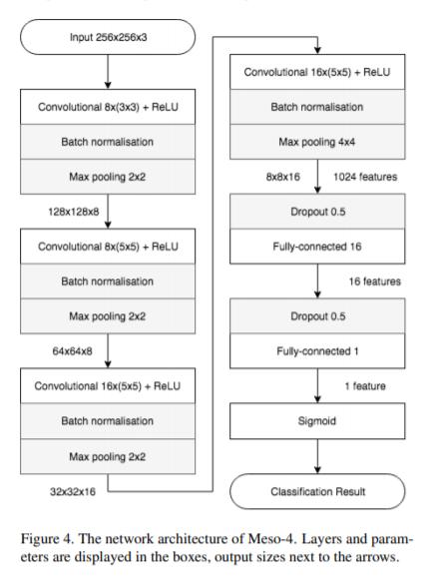
Present Work: Classification Setup
Implemented the Meso4 architecture as shown in MesoNet paper in an effort to reproduce the results obtained by the authors, thereby having a baseline reading
Input Shape = 200 x 200 x 3
Testing set was divided into 80:20 ratio for training and model validation purposes simultaneously.
Epochs = 200
Batch Size = 75
Learning Rate = 0.001 (fixed)
Optimizer: ADAM with default parameters (β1 = 0.9 and β2 = 0.999)
Figure 1: The network architecture of Meso4

Slide 5
Present Work: Results
Achieved successful detection of deepfake images from real images, albeit with a lower accuracy than the authors
Model is falsely flagging many of the Real images as Fake, thus the low accuracy on Real Images
Positive is Fake class
Negative is Real class
Fake Images | 96%
Real Images | 84%
Total Accuracy | 89%
Table 2: Classification scores of my Meso4 implementation on Deepfake dataset
True Positive | 2734
False Positive | 111
False Negative | 664
True Negative | 3595
Table 3: Confusion Matrix showing classification scores of Meso4 implementation on deepfake dataset.

Slide 6
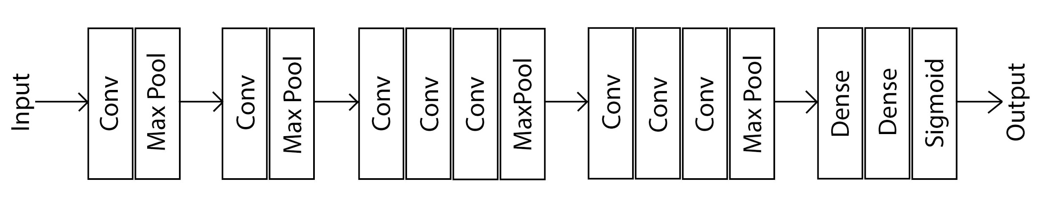
Future Work: Plan of Action
Improve present detection rates, especially for Real Images which are being detected with significantly lower accuracy.
Testing the model on a different dataset with higher compression levels.
Adding a bunch of Conv Layers, as shown in figure (similar to what VGG-16 does)
If the number of trainable params increase substantially, resulting in huge training times, 1x1 conv layers may be used to decrease the number of feature maps while still retaining their salient features
Figure 2: Architecture of my proposed model for deepfake classification, based on the Meso4 network, with several convolutional blocks added (inspired by VGG-16)

Slide 7
Thank You

